Slide 1
Instruction Pattern Search
Metodi Mitkov 28.03.2022

Slide 2
Installation and Dependencies
Python 3.7 and above
Clone GitHub repository – https://github.com/metodi022/instrsearch
Create a python virtual environment
Install angr (framework for analysing binaries)

Slide 3
Usage
Arguments
-p PATH path to binary file
-s SEARCH search pattern
Optional Arguments
-b BASE base address of binary in hex
-a ARCH architecture of binary
-o OUTPUT CSV output location
-v verbose mode; prints output in console
-d debug mode; prints additional information

Slide 4
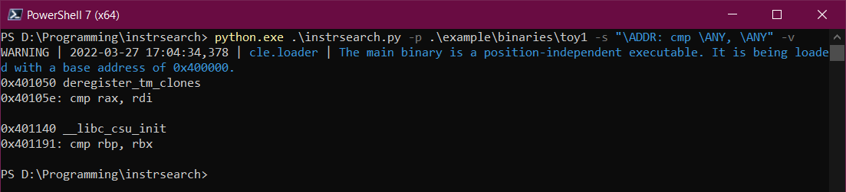
Simple Example 1
angr will print warnings and errors during the analysis process

Slide 5
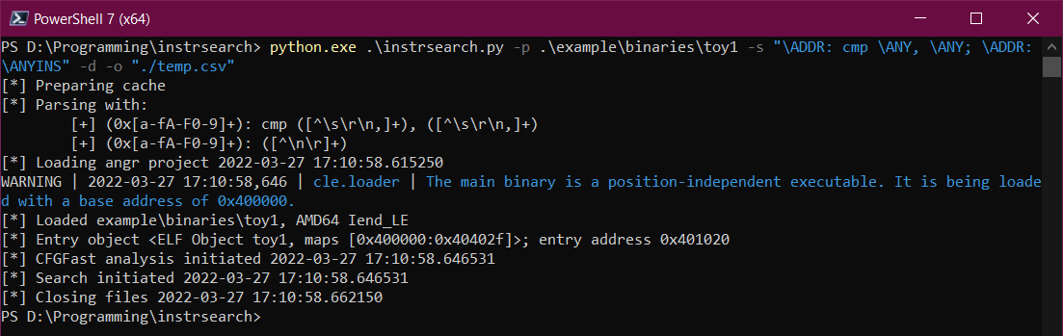
Simple Example 2

Slide 6
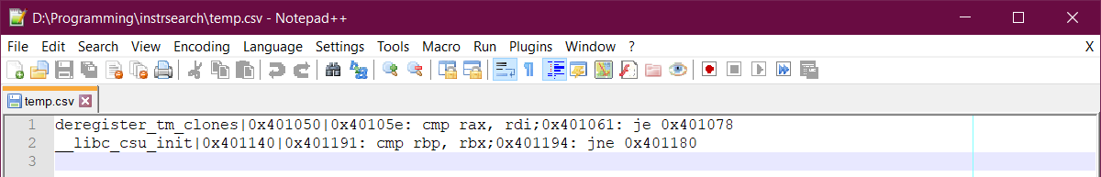
CSV Output Format
| separator for CSV values
; separator for instructions
Function Name|Function Address|instruction;instruction

Slide 7
Search Pattern
Any valid python RegEx expression [a-zA-Z0-9]{2,6}(1234)+
Each instruction begins with \ADDR: cmp rax, rcx
Multiple instructions can be chained \ADDR: cmp rax, rcx; \ADDR: jg 0x1234
Shortcuts
\GP matches any general purpose register
\IMM matches any immediate value
\ADDR matches any address \DEREF matches any dereference
\AVX matches any AVX register \ANY matches any mnemonic or operand
\ANYINS matches any instruction

Slide 8
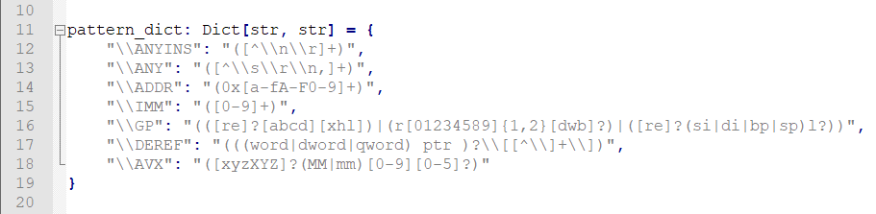
Extending Search Pattern
Shortcuts can be easily extended in the code

Slide 9
Example Searches
\ADDR: cmp \GP, \ANY; \ADDR: \ANYINS
\ADDR: add eax, eax; (\ADDR: \ANYINS){2,4}; \ADDR: sub eax, ecx

Slide 10
Performance – Ubuntu Focal Kernel (~17MB)
Initial run of a binary
First analysis ~15 minutes
Search ~2 minutes
Subsequent runs of the same binary
Reload cached analysis ~1 minute
Search ~2minutes
Improved runtime by caching analysed functions on first run.
Quick integrity check with md5.

Slide 11
Limitations
angr disassembly not perfect – disassembly errors resulting in blocks or functions not disassembled
Basic block granularity
No dynamic analysis
\ADDR: in \ANY, 0x3d
✅ in rax, 0x3d
❌ mov rax, 0x3d
❌ in rcx, rax

